Slide 1
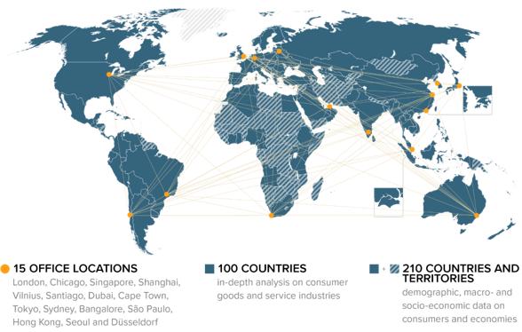
Euromonitor International
3
About us
World leading strategic and tactical market research company for private sector, public sector and
government and academic institutions
Founded in 1972, Independent and privately held
HQ in London with 1,300+ staff based in 15 regional offices around the world
Global industry network
1,000+ on-the-ground researchers based in 100 countries

Slide 2







































Research Expertise
Beauty & Fashion
Drinks &Tobacco
Economies &
Consumers
Food & Nutrition
Home&Tech
Services &
Payments
Apparel and
Footwear
Alcoholic Drinks
Business Dynamics
Cooking Ingredients
and Meals
Mobility
Consumer Finance
Beauty and
Personal Care
Cannabis
Cities
Dairy Products
and Alternatives
Consumer
Appliances
Consumer
Foodservice
Hot Drinks
Digital Consumer
Consumer Health
Fresh Food
Consumer
Electronics
Retailing
Soft Drinks
Economy, Finance
and Trade
Eyewear
Tobacco
Health & Wellness
Sports
Households
Home and Garden
Luxury Goods
Nutrition
Travel
Income and
Expenditure
Home Care
Personal
Accessories
Survey
Pet Food
Tissue and Hygiene
Beauty Survey
Industrial
Toys and Games
Supply
Cannabis Survey
Product Claims and
Positioning
Ingredients
Analytics
Lifestyles
Packaging
Competitor
Analytics
Digital Consumer
Survey
Sustainability
Snacks
Health and
Nutrition Survey
Population
Staple Foods
Industry Forecast
Models
Lifestyle Survey
Nicotine Survey
Mobility System
Survey

Slide 3
Up to 100 In-Country Research Programmes
Africa and the
Middle East
Algeria
Angola
Cameroon
Côte d'Ivoire
Egypt
Ethiopia
Ghana
Iraq
Israel
Jordan
Kenya
Kuwait
Lebanon
Morocco
Nigeria
Oman
Qatar
Saudi Arabia
South Africa
Tanzania
Tunisia
Uganda
United Arab Emirates
Asia Pacific
Azerbaijan
Bangladesh
Cambodia
China
Hong Kong, China
India
Indonesia
Japan
Kazakhstan
Laos
Malaysia
Myanmar
Pakistan
Philippines
Singapore
South Korea
Sri Lanka
Taiwan
Thailand
Uzbekistan
Vietnam
Australasia
Australia
New Zealand
Eastern Europe
Belarus
Bosnia-Herzegovina
Bulgaria
Croatia
Czech Republic
Estonia
Georgia
Hungary
Latvia
Lithuania
Macedonia
Poland
Romania
Russia
Serbia
Slovakia
Slovenia
Ukraine
Latin America
Argentina
Bolivia
Brazil
Chile
Colombia
Costa Rica
Dominican Republic
Ecuador
El Salvador
Guatemala
Honduras
Mexico
Panama
Paraguay
Peru
Uruguay
Venezuela
North America
Canada
USA
Western Europe
Austria
Belgium
Denmark
Finland
France
Germany
Greece
Ireland
Italy
Netherlands
Norway
Portugal
Spain
Sweden
Switzerland
Turkey
United Kingdom
Added in 2017

Slide 4
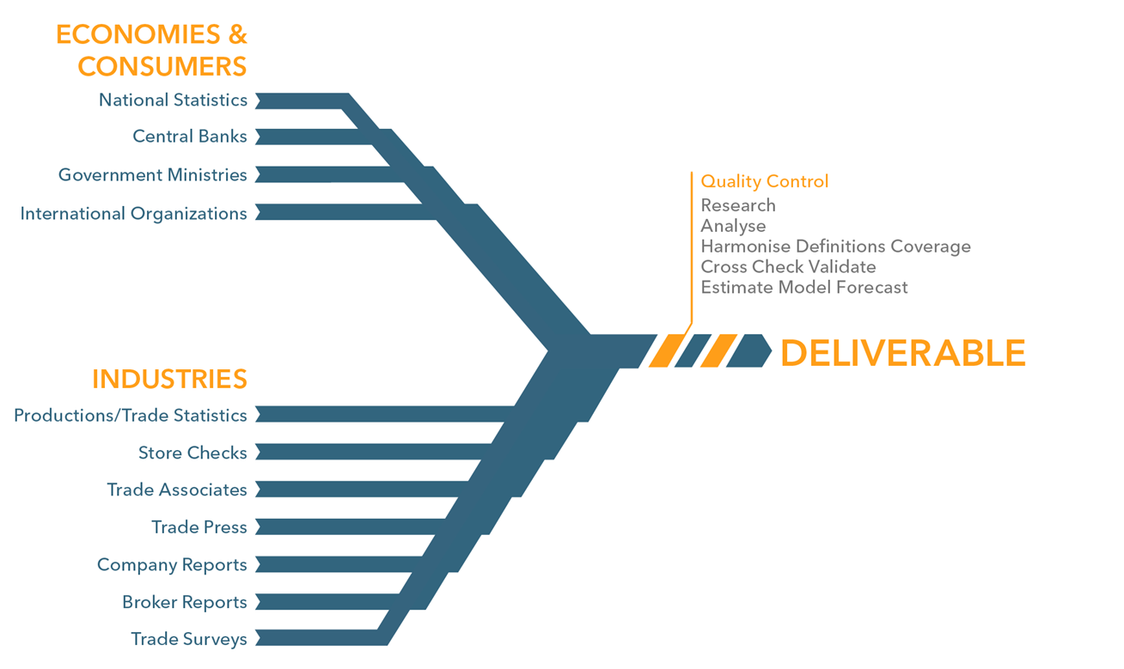

Syndicated Research Methodology
RESEARCH APPROACH

Slide 5
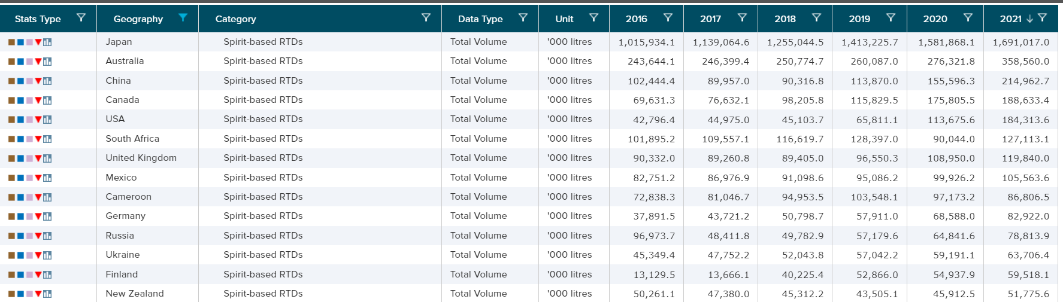
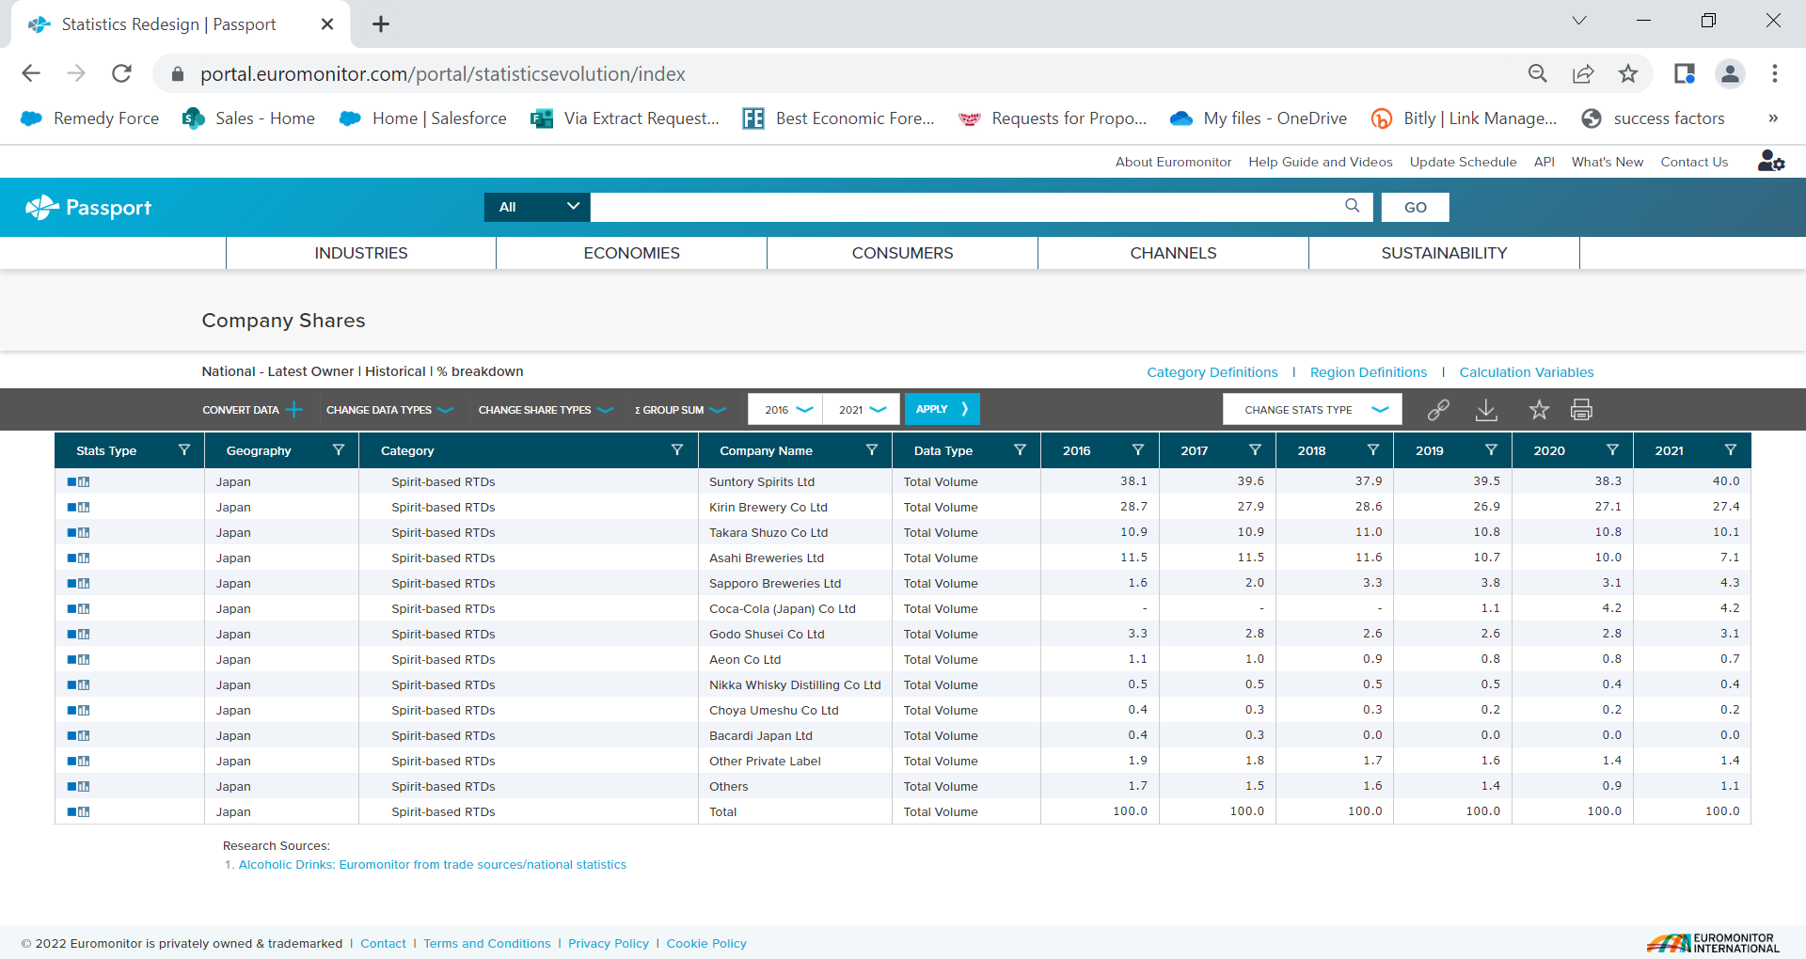
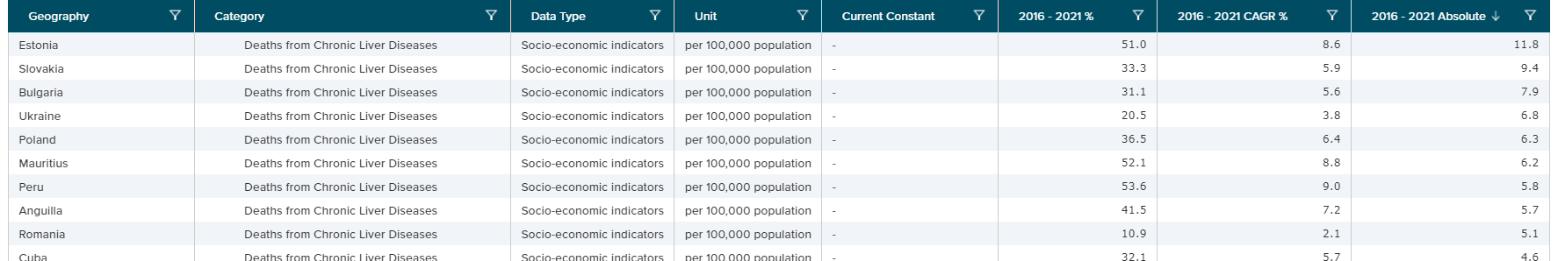
SAMPLE STATISTICS

Slide 6
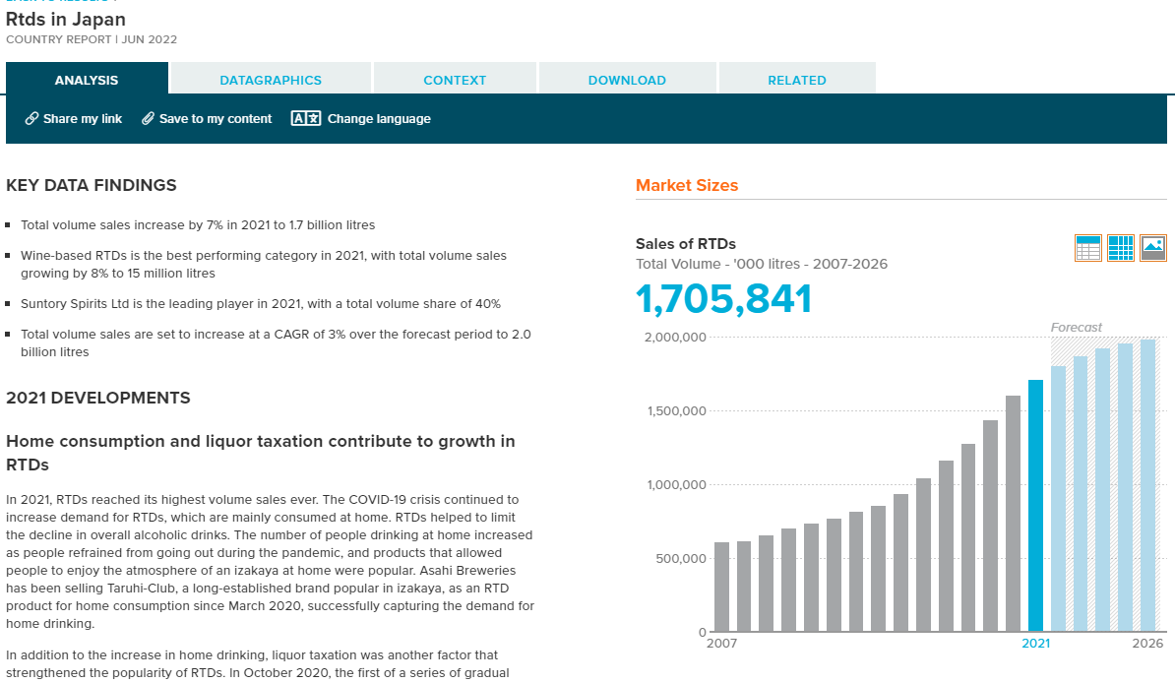
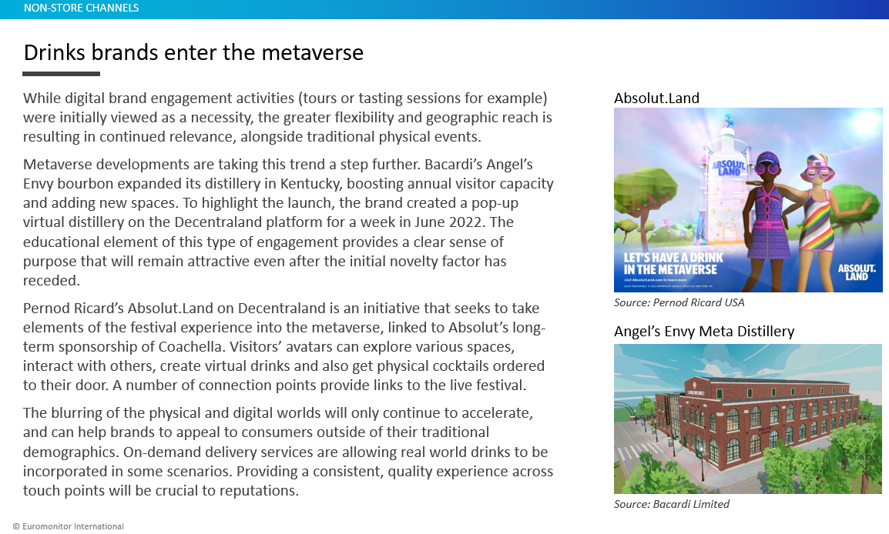
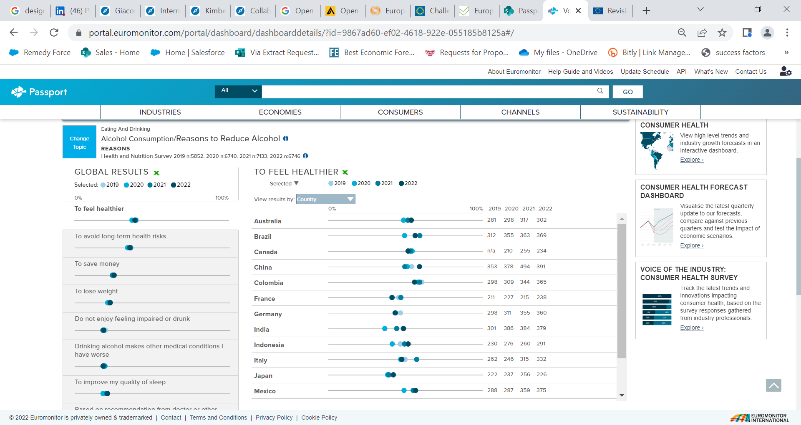
SAMPLE REPORTS

Slide 7
Request for Data and Publication Rights Flow Diagram
Request for data received by Euromonitor
Meeting set up to understand exact data requirements, budget availability and intended use of the data (internal/external publication etc.)
Order form/data license drafted inclu. IPR permissions (if needed). Once signed, data provided within 24hrs.
Ongoing query handling and citation support is included (with response times of no less than 48hrs)

Slide 8


Thank You
Ruth. magaro@euromonitor.com
https://www.linkedin.com/in/ruth-magaro-b0713b7/
Office: +44 207 251 8024 # 1353

